Slide 1

KALLAM HARANADHAREDDY INSTITUTE OF TECHNOLOGY
(AUTONOMOUS)
Approved by (AICTE., New Delhi; Permanently Affiliated Io JTNTU KAKINADA)
Accredited by NAAC with ‘A’ Grade, NH- 16, Chowdavaram,Guntur-522019 (AP)
Department of CSE(Artificial Intelligence and Machine Learning)
Project Title : Automated Fraud Detection in Digital Payment
Team Members:-
Guided By:
Mr.M.Chennakesava Rao,M.E (Ph.D)
Assistant Professor,
Dept. of CSE(AIML)
N.Pardha Naga Venkata Sai 228X1A4286
P. Harsha Vardhan 228X1A42A4
N. Anantha 228X1A4289
M. Nani 228X1A42C1

Slide 2
CONTENTS
● Abstract
● Literature Survey
● Architecture
● Methodology
● Summary of Project
● Design & Implementation
● Output
● Conclusion

Slide 3

Abstract
SecurePay is an intelligent system designed to proactively detect and prevent fraud in online transactions using ML.By analyzing transaction patterns from a large-scale dataset, the project evaluates multiple classification algorithms.

Slide 4
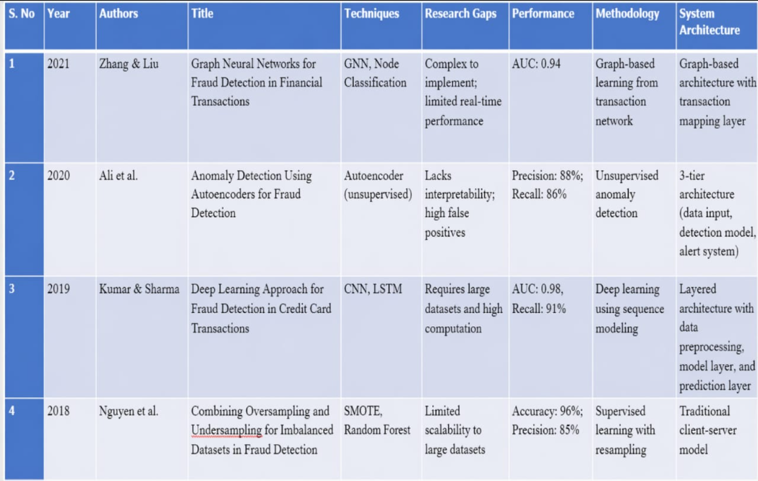
Literature of Survey

Slide 5
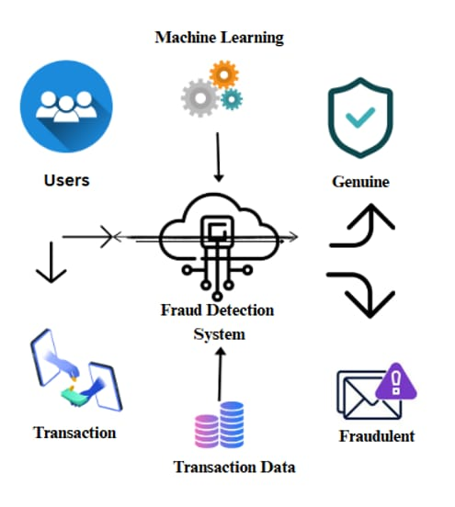
Architecture

Slide 6
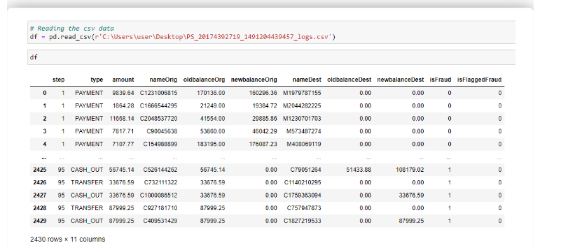
Methodology
● Data Collection:-
Collected historical online payment transaction data
Link:-https://www.kaggle.com/datasets/rupakroy/online-payments-fraud-detection-dataset

Slide 7
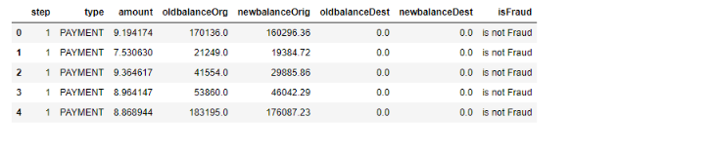
● Data Preprocessing(dropped superfluous):-
Removed missing and inconsistent values

Slide 8
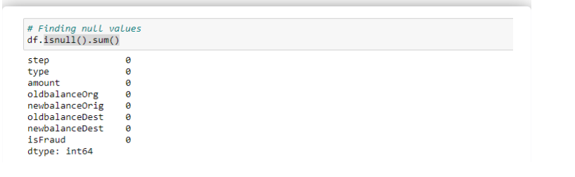
● Checking for Null Values:-
Checking for null values is an important step in the data preprocessing phase

Slide 9
● Feature Engineering:-
● Math Check:- Math check is performed to validate the numerical consistency and correctness of the dataset It ensures that all mathematical relationships and calculations within the data are accurate Performing math checks helps in preventing incorrect model training and improves overall data reliability.
● Data cleaning:-Data cleaning is the process of identifying and correcting errors or inconsistencies in the dataset. It includes handling missing values, removing duplicate records, correcting data types, and eliminating outliers. In this project, null values are treated using appropriate techniques such as mean, median, or mode imputation.
● Label encoding:- Label encoding is a preprocessing technique used to convert categorical data into numerical form so that machine learning algorithms can process it. In this method, each unique category is assigned a numerical value.
Cash Out-1
Payment-2
Cash In-3
Transfer-4
Debit-5

Slide 10
● Model Training:-
● After completing data preprocessing and feature engineering, the dataset was divided into training data and
testing data for model development.
● Two machine learning algorithms were used for training the fraud detection model: Random Forest and XGBoost.
● The Random Forest model was first trained on the dataset to learn patterns of normal and fraudulent transactions using multiple decision trees.
● Next, the XGBoost model was trained, which is an advanced boosting algorithm that improves prediction accuracy by combining multiple weak learners.
● Both models were evaluated using performance metrics such as accuracy and prediction score to determine their effectiveness in fraud detection.
● After comparison, XGBoost performed better than Random Forest, achieving a higher accuracy and better prediction performance.
● Therefore, the XGBoost model was selected as the final model for detecting fraudulent digital payment transactions.

Slide 11
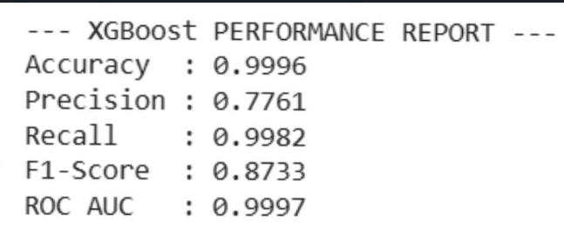
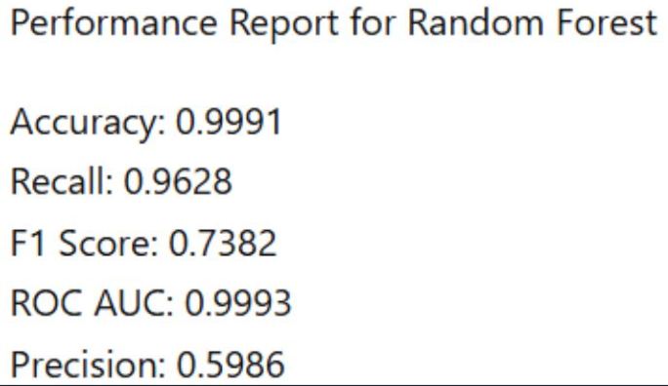
● Evaluation:-
● In the evaluation stage, the performance of the trained machine learning models was tested using the testing dataset. The models used for evaluation were Random Forest and XGBoost.
● Both models were evaluated using performance metrics such as accuracy, precision, recall, and prediction score to measure how well the models could identify fraudulent and legitimate transactions. These metrics help in understanding the effectiveness of the fraud detection system.
● After comparing the results, the XGBoost model performed better than the Random Forest model by achieving a higher accuracy and better prediction performance. Because of its better evaluation score, XGBoost was selected as the final model for the fraud detection system.

Slide 12
● Development:-
● The fraud detection system was developed using machine learning techniques to analyze digital payment transactions.
● The project was implemented using the Python programming language and data science libraries such as Pandas, NumPy, Scikit-learn, and XGBoost
● First, the dataset was imported and processed using Pandas for data analysis and manipulation.
● Data preprocessing and feature engineering techniques were applied to prepare the dataset for model training.
● Machine learning models were then developed and trained to detect fraudulent transactions
●The trained model was integrated into the system to predict whether a transaction is fraudulent or legitimate.
●The final system helps improve security in digital payment platforms by automatically detecting suspicious transactions.

Slide 13
Summary of Project
● The project Automated Fraud Detection in Digital Payment is designed to identify fraudulent transactions in online payment systems using Machine Learning(Xg boost) techniques. With the rapid growth of digital payments, fraud activities have also increased
● This project aims to build an intelligent system that can automatically analyze transaction data and detect suspicious activities
● The system uses a large dataset of online payment transactions to study patterns and behaviors of both normal and fraudulent transactions
● By applying machine learning classification algorithms, the model learns to differentiate between legitimate and fraudulent transactions
● The dataset is first preprocessed by removing missing values, cleaning inconsistent data, and transforming categorical data into numerical form using label encoding.
● This helps banks and online payment platforms detect fraud in real time, reduce financial losses, and improve customer trust in digital payment systems.

Slide 14
Design & Implementation
● First, the data collection stage was performed using a publicly available dataset of online payment transactions from Kaggle. This dataset contains various attributes such as transaction type, amount, and account details that help in identifying fraudulent patterns.
● Next, data preprocessing was carried out to prepare the dataset for machine learning. In this stage, missing values and inconsistent data were removed. The dataset was cleaned by eliminating duplicate records and correcting incorrect data types. Checking for null values ensured that the dataset was complete and reliable for further analysis.
●After preprocessing, feature engineering was applied to improve the quality of the dataset. Mathematical checks were performed to verify the correctness of numerical values in the dataset. Categorical variables such as transaction type were converted into numerical form using label encoding, which helps machine learning algorithms process the data efficiently.
●Once the dataset was prepared, the model training phase was conducted. Two machine learning algorithms, Random Forest and XGBoost, were used to train the model for fraud detection. Both algorithms were trained using the processed dataset to learn the patterns of fraudulent and legitimate transactions.

Slide 15
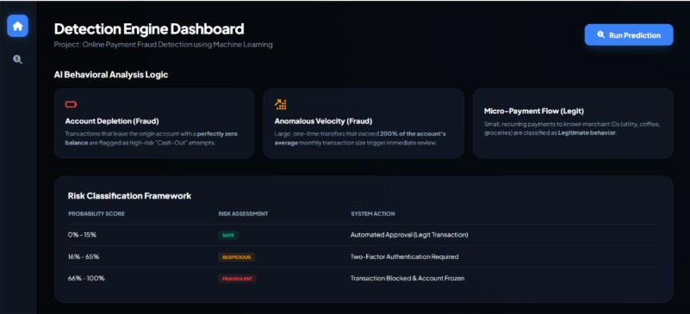
● During the evaluation stage, the performance of both models was compared based on their accuracy and prediction scores. The results showed that the XGBoost model performed better than Random Forest, achieving a higher performance score and better accuracy in identifying fraudulent transactions.
●Finally, the trained XGBoost model was used as the final model in the system to predict whether a transaction is fraudulent or genuine. This implementation helps in detecting fraud efficiently and improves the security of digital payment systems.

Slide 16
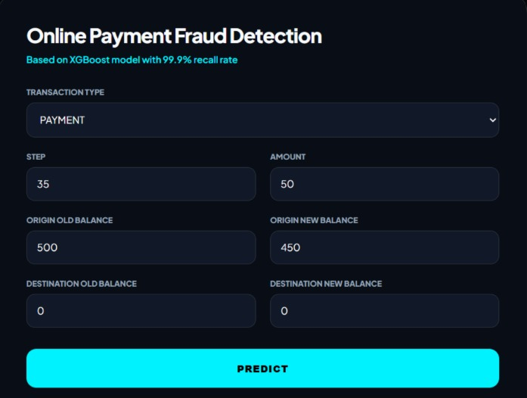
Output

Slide 17
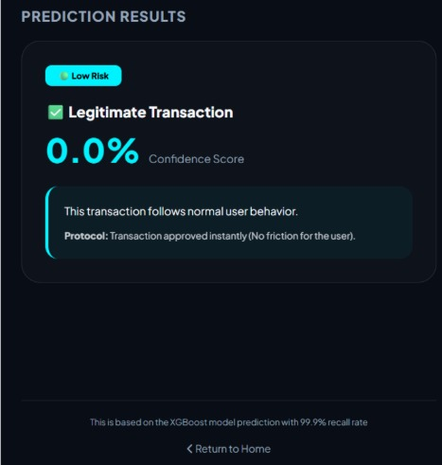

Slide 18
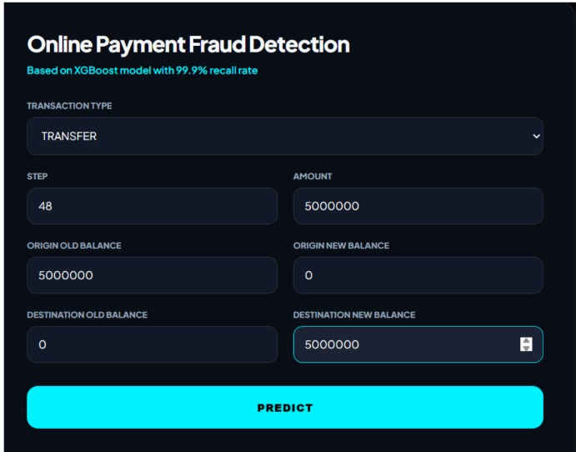

Slide 19
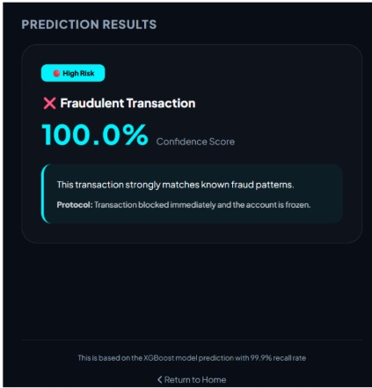

Slide 20
CONCLUSION
●The project proves that ML is a powerfull and effective tool to prevent online payment fraud.
●This tool can help business and individuals to reduce financial losses from fraudulent transactions.
●Users can easily input transaction details through the web
Interface to get a prediction.
●The project confirms that machine learning is an indispensable tool for building the next generation of intelligent security systems.

Slide 21
PAPER PUBLICATION
Link:-https://www.ijirset.com/upload/2026/march/250_Automated%20Fraud%20Detection%20in%20Digital%20Payments.

Slide 22
THANK YOU

